Slide 1
REAL-TIME KERNELS
REAL-TIME KERNELS
A process is an abstraction of a running program and is the logical unit of work scheduled by the operating system represented by a data structure that contains
a state of execution
an identity (real-time)
attributes (e.g., execution time)
the resources associated with it.
A thread is a lightweight process that shares resources with other processes or threads.
Each thread must “reside” within some process and make use of the resources of that process.
Threads that reside within the same process share that processes’ resources.

Slide 2
REAL-TIME KERNELS
The kernel of Real-time operating systems must provide three specific functions with respect to tasks:
Scheduling
A scheduler determines which task will run next in a multitasking system
Dispatching
A dispatcher performs the necessary bookkeeping to start that task
Intercommunication and Synchronization.
Inter-task communication and synchronization assures that the tasks cooperate.

Slide 3
REAL-TIME KERNELS
In an embedded system this essentially represents the entire real time system but in commercial realtime operating system this might be all but the device drivers.
Layers of operating system functionality:
Nanokernel provides simple thread (lightweight process) management. It essentially provides only one of the three services provided by a kernel, task scheduling
Microkernel in addition provides for task scheduling.
A kernel also provides for inter-task synchronization and communication via semaphores, mailboxes etc.
A real-time executive is a kernel that includes privatized memory blocks, I/O services etc.
Most commercial real-time kernels are executives.
An operating system is an executive that provides for a generalized user interface, security, and a file-management system.
UNIX Operating system is indeed an operating system

Slide 4
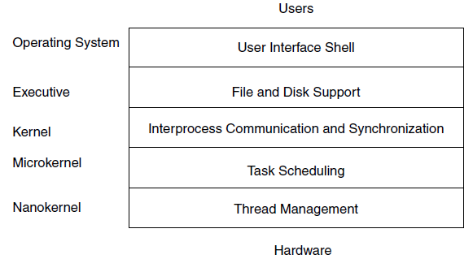
REAL-TIME KERNELS

Slide 5
REAL-TIME KERNELS
Regardless of the operating system architecture used, the objective is to
satisfy real-time behavioral requirements
provide a flawless multitasking environment
that is flexible and robust.
Pseudokernels
Real-time multitasking can be achieved without interrupts and even without an operating system
When feasible, these approaches are preferred because resultant systems are easier to analyze.

Slide 6
Pseudokernels: Polled Loop
Polled loops are used for fast response to single devices.
In a polled-loop system, a single and a repetitive instruction is used to test a flag that indicates whether or not some event has occurred. The polling continues if the event has not occurred.
A software system is needed to handle packets of data that arrive at a rate of no more than 1 per second.
A flag named packet_here is set by the network, which writes the data into the CPU’s memory via direct memory access (DMA).
The data are available when packet_here = 1.

Slide 7
Pseudokernels: Polled Loop
Using a C code fragment, such a polled loop to handle such a system is:
for(;;) { /* do forever */
if (packet_here) /* check flag */
{
process_data(); /* process data */
packet_here=0; /* reset flag */
}
}
Polled-loop schemes work well when a single processor is dedicated to handling the I/O for some fast device and when overlapping of events is not allowed or minimized.
Polled loops are ordinarily implemented as a background task in an interrupt-driven system, or as a task in a cyclic executive.
In case of a cyclic executive, the polled loop polls each cycle for a finite number of times to allow other tasks to run. Other tasks handle the nonevent-driven processing.
No inter task communication or scheduling is needed as only a single task exists
e.g. IBM’s OS/2 Presentation Managers reads the application queue using a polled loop

Slide 8
Pseudokernels: Synchronized Polled Loop
A variation on the polled loop uses a fixed clock interrupt to pause between the time when the signaling event is triggered and then reset.
Such a system is used to treat events that exhibit switch bounce.
Switch bounce is a phenomenon that occurs because it is impossible to build a switch, whether mechanical or electrical, that can change state instantaneously.
Events triggered by switches, levers, and buttons all exhibit this phenomenon.
If, however, a sufficient delay occurs between the initial triggering of the event and the reset, the system will avoid interpreting the settling oscillations as events.

Slide 9
Pseudokernels: Synchronized Polled Loop
These are fake events that would surely overwhelm any polled loop service.
For instance, suppose a polled-loop system is used to handle an event that occurs randomly, but no more than once per second.
The event is known to exhibit a switch-bounce effect that disappears after 20 milliseconds.
A 10-millisecond fixed-rate interrupt is available for synchronization.

Slide 10
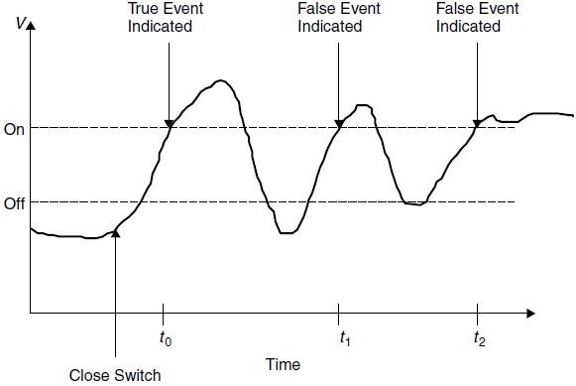
Pseudokernels: Synchronized Polled Loop

Slide 11
Pseudokernels: Synchronized Polled Loop
The event is signaled by an external device that sets a memory location via DMA. A delay period can be realized with a programmable timer that issues an interrupt after a countdown period, but in absence of such hardware a software routine can be written to implement the delay and the C code looks like the following:
for(;;) { /* do forever */
if(flag) /* check flag */
{
pause(20); /* wait 20 ms */
process_event(); /* process event */
flag=0; /* reset flag */
}
}
Polled loops inherently waste CPU time, especially if the event being polled occurs infrequently.

Slide 12
Pseudokernels: Cyclic Executives
Cyclic executives are non interrupt-driven systems that can provide the illusion of simultaneity by taking advantage of relatively short processes on a fast processor in a continuous loop.
Example, consider the set of self-contained processes Process1 through Process_N in a continuous
loop as depicted below:
for(;;) { /* do forever */
Process_1();
Process_2();
...
Process_N();
}

Slide 13
Pseudokernels: Cyclic Executives
A de facto cycle rate is established, which is the same for each task, as they execute in “round-robin” fashion. Different rate structures can be achieved by repeating a task in the list.
for(;;) { /* do forever */
Process_1();
Process_2();
Process_3();
Process_3();
}
Process_3 runs twice as frequently as Process_1 and Process_2.
The task list can be made adjustable by keeping a list of pointers to processes that are managed by the “operating system” as tasks are created and completed, weighted round-robin fashion.
Intertask synchronization and communication can be achieved through global variables or parameter lists.

Slide 14
Pseudokernels: Cyclic Executives
Space Invaders game
Servicing three button events
Left movement of the tank
Right movement of the tank
Fire missile
Tasks:
Moving the aliens
Computing collisions
Updating the screen
Cyclic executive for the Game?

Slide 15
Pseudokernels: Cyclic Executives
for(;;) { /* do forever */
check_for_keypressed();
move_aliens();
check_for_keypressed();
check_for_collison()
check_for_keypressed();
update_screen();
}
The process check_for_keypressed, which services the three button pressings, contains the processes move_tank and fire_missile, and is executed three times as frequently as the others in order to provide faster response to user input.
If each process is relatively short and uniform in size, then reactivity and simultaneity can be achieved without interrupts.
Moreover, if each process is carefully constructed including synchronization through messaging or global variables, complete determinism and schedulability can be achieved.
Cyclic executives are, however, inadequate for all but the simplest of real-time systems because of the difficulties in uniformly dividing the processes and in the long response times that are created

Slide 16
Pseudokernels: State-Driven Code
State-driven code uses nested if–then statements, case statements, or finite state automata to break up the processing of functions into code segments.
The separation of processes allows each to be temporarily suspended before completion, without loss of critical data facilitating multitasking via a scheme such as coroutines.
State-driven code works well in conjunction with cyclic executives when the processes are too long or nonuniform in size.
Communications program such as network packet handlers are broken up into phases.
Some processes are therefore unsuitable for this technique as
- they cannot be divided into states
the tables needed to implement the code can become quite large.
the manual translation process from the finite state automaton to tabular form is error-prone.

Slide 17
Pseudokernels: Coroutines
Coroutines or cooperative multitasking systems require disciplined programming and an appropriate application.
These types of kernels are employed in conjunction with code-driven by finite state automata.
In this scheme, two or more processes are coded in the state-driven fashion, and after each phase is complete, a call is made to a central dispatcher.
The dispatcher holds the program counter for a list of processes that are executed in round-robin fashion and aids in selecting the next process to execute.
If there is only one coroutine, then it will be repeated cyclically, such a system is called a cycle executive.
Communication between the processes is achieved via global variables that hold data that needs to be preserved between dispatches.

Slide 18
Pseudokernels: Coroutines
Consider a system in which two processes are executing “in parallel” and in isolation.
After executing phase_a1, process_a returns control to the central dispatcher by executing break.
The dispatcher initiates process_b, which executes phase_b1 to completion before returning control to the dispatcher.
The dispatcher then starts process_a, which begins phase_a2, and so on.

Slide 19
Pseudokernels: Coroutines
void process_a(void)
{
for(;;)
{
switch(state_a)
{
case 1: phase_a1();
break;
case 2: phase_a2();
break;
case 3: phase_a3();
break;
case 4: phase_a4();
break;
case 5: phase_a5();
break;
}
}
}
void process_b(void)
{
for(;;)
{
switch(state_b)
{
case 1: phase_b1();
break;
case 2: phase_b2();
break;
case 3: phase_b3();
break;
case 4: phase_b4();
break;
case 5: phase_b5();
break;
}
}
}

Slide 20
Pseudokernels: Coroutines
In addition, the processes can be written by independent parties, and the number of processes need not be known beforehand.
Applications implemented using coroutines;
IBM’s old transaction processing system
Customer Information Control System (CICS)
IBM’s OS/2 Presentation Manager used coroutines to coordinate the activities within the various user windows.

Slide 21
Pseudokernels: Coroutines
Issues regarding Coroutines:
- Any use of coroutines assumes that each task can relinquish the CPU at regular intervals.
- It also requires a communication scheme involving global variables, which is undesirable.
- processes cannot always be easily decomposed uniformly, which can adversely affect response time since the minimum size is a function of the longest phase.

Slide 22
Interrupt-Driven Systems
In interrupt-driven systems, the main program is a single jump-to-self instruction.
The various tasks in the system are scheduled via either hardware or software interrupts, whereas dispatching is performed by the interrupt-handling routines.
Hardware scheduling
- A clock or other external device issues interrupt signals that are directed to an interrupt controller.
- The interrupt controller issues interrupt signals, depending on the order of arrival and priority of the interrupts involved.
- If the computer architecture supports multiple interrupts, then the hardware handles dispatching as well.
- If only a single interrupt level is available, then the interrupt- handling routine will have to read the interrupt vector on the interrupt controller, determine which interrupts occurred, and dispatch the appropriate tasks.
- Some processors implement this in microcode, and so the operating systems designer is relieved of this duty.

Slide 23
Interrupt-Driven Systems
Interrupt Signals and Priorities
Interrupt Signals
Dispatch Task
External Devices
Interrupt Controller
Interrupt Handling Routine
Read interrupt vector

Slide 24
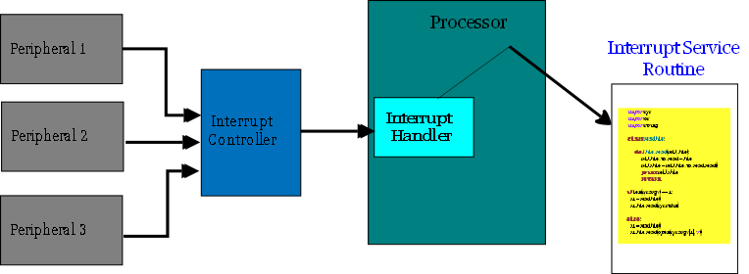
Interrupt-Driven Systems

Slide 25
Interrupt-Driven Systems: Interrupt Service Routines
In any system, there are two kinds of interrupts:
Hardware Interrupt
A signal generated by a peripheral device and sent to the CPU.
In turn, CPU executes an interrupt service routine (ISR), which takes action in response to interrupt.
The trigger of a hardware interrupt is an electrical signal from an external device,
Hardware interrupts are asynchronous in nature, that is, an interrupt can happen at any time.
Software Interrupt
Similar to the hardware interrupt, in that it causes one code module to pass control to another.
The trigger of a software interrupt is the execution of a machine language instruction.

Slide 26
Interrupt-Driven Systems: Interrupt Service Routines
A common concept found in programming languages is that of an exception, which is akin to an internal interrupt that is triggered by a program’s attempt to perform an unexpected or illegal operation.
All three situations cause the CPU to transfer execution to a known location and then execute code associated with that situation.
Often an application developer is required to write an ISR for a specific type of hardware interrupt.
For this, it is important to understand what constitutes the CPU state, and whether ISRs must preserve anything in addition to general registers.
Access to resources shared with an ISR is usually controlled by disabling interrupts in the application around any code that reads or writes to the resource.

Slide 27
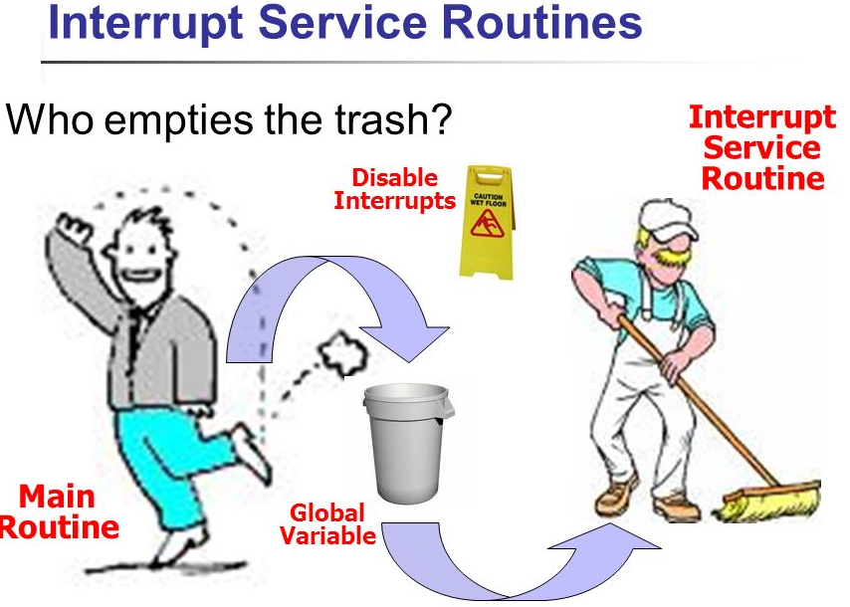

Slide 28
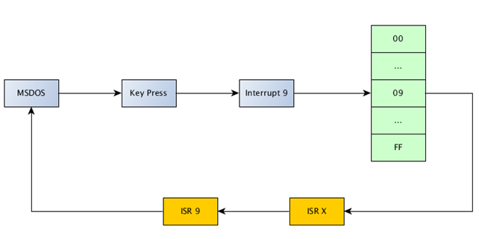

Slide 29
Interrupt-Driven Systems: Interrupt Service Routines
Synchronization mechanisms cannot be used in an ISR because it is not possible for an ISR to wait indefinitely for a resource to be available.
When interrupts are disabled, the system’s ability to receive stimuli from the outside world is minimal.
It is important to keep the critical sections of code in which the interrupts are disabled as short as possible.
If the ISR takes too long to process an interrupt, the external device may be kept waiting too long before its next interrupt is serviced.

Slide 30
Interrupt-Driven Systems: Interrupt Service Routines
Reentrant code can execute simultaneously in two or more contexts.
An ISR is said to be reentrant if, while the ISR is handling an interrupt, the same interrupt can occur again and the ISR can process the second occurrence of the interrupt before it has finished processing the first.
Regardless of the type of ISR to be written, a snapshot of the machine – called the context – must be preserved upon switching tasks so that it can be restored upon resuming the interrupted process.

Slide 31
Interrupt-Driven Systems: Context Switching
Context switching is the process of saving and restoring sufficient information for a real-time task so that it can be resumed after being interrupted.
The context is ordinarily saved to a stack data structure.
Context-switching time is a major contributor to response time and therefore must be minimized.
Rule for saving context :
Save the minimum amount of information necessary to safely restore any process after it has been interrupted.

Slide 32
Interrupt-Driven Systems: Context Switching
This information ordinarily includes
- Contents of general registers
- Contents of the program counter
- Contents of coprocessor registers
- Memory page register
- Images of memory-mapped I/O locations (mirror images)
Within the interrupt handlers, interrupts are disabled during the critical context-switching period.

Slide 33
Interrupt-Driven Systems: Context Switching
Sometimes, however, after sufficient context has been saved, interrupts can be enabled after a partial context switch in order to handle a burst of interrupts, to detect spurious interrupts, or to handle a time over loaded condition.
The stack model for context switching is used mostly in embedded systems where the number of real-time or interrupt-driven tasks is fixed and each interrupt handler is associated with a hardware interrupt and is invoked by the CPU, which vectors to the instruction stored at the appropriate interrupt-handler location.

Slide 34
Interrupt-Driven Systems: Context Switching
The context is then saved to a specially designated memory area that can be static, in the case of a single interrupt system, or a stack, in the case of a multiple-interrupt system.

Slide 35
Interrupt-Driven Systems: Context Switching
Pseudocode for a partial real-time system, written in C, and consisting of a simple jump-to-self and three interrupt handlers. Each saves context using the stack model.
void main(void)
/*initialize system, load interrupt handlers */
{
init();
while(TRUE); /* infinite wait loop */
}
void intl (void) /* interrupt handler 1 */
{
save(context); /* save context on stack */
task1(); /* execute task 1 */
restore(context); /* restore context from stack */
}
void int2(void) /* interrupt handler 2 */
{
save(context); /* save context on stack */
task2(); /* execute task 2 */
restore(context); /* restore context from stack */
}
void int3(void) /* interrupt handler 3 */
{
save(context); /* save context on stack */
task3(); /* execute task 3 */
restore(context); /* restore context from stack */
}
Procedure save saves certain registers to a stack area,
Procedure restore restores those registers from stack.

Slide 36
Interrupt-Driven Systems: Context Switching
Save and restore would actually take two arguments;
- a pointer to data structure representing the context information
- a pointer to the stack data structure.
In the case of the context data structure, the programming language compiler must provide a mechanism to extract the current contents of the general registers, PCs, and so forth.
Both save and restore must adjust the stack pointer.

Slide 37
Preemptive-Priority Systems
A higher-priority task is said to preempt a lower-priority task if it interrupts the lower-priority task.
Systems that use preemption schemes instead of round-robin or first-come-first-served scheduling are called preemptive-priority systems.
The priorities assigned to each interrupt are based on the urgency of the task associated with the interrupt.
For example, the nuclear power station monitoring system is best designed as a preemptive-priority system. While the handling of intruder events is critical, for example, nothing is more important than processing the core over-temperature alert.

Slide 38
Preemptive-Priority Systems
Prioritized interrupts can be either fixed priority or dynamic priority.
Fixed priority systems are less flexible, since the task priorities cannot be changed. e.g. nuclear power station monitoring system, processing the core over temperature is always more important than handling intruder events
Dynamic-priority systems can allow the priority of tasks to be adjusted at runtime to meet changing process demands. E.g. military aircraft, thereat management computer tracking six enemy aircrafts, readjusting the priorities of tasks managing individual threat by re-computing relative threat of each enemy aircraft based on proximity , posture and other factors

Slide 39
Preemptive-Priority Systems
Preemptive-priority schemes can suffer from resource hogging by higher priority tasks leading to a lack of available resources for lower-priority tasks, facing a problem called starvation.
A special class of fixed-rate preemptive-priority interrupt-driven systems, called rate-monotonic systems, comprises those real-time systems where the priorities are assigned so that the higher the execution frequency, the higher the priority.
This scheme is common in embedded applications, particularly avionics systems
For example, in the aircraft navigation system, the task that gathers accelerometer data every 10 milliseconds has the highest priority. The task that collect gyro data, and compensates these data and the accelerometer data every 40 milliseconds, has the second highest priority. Finally, the task that updates the pilot’s display every second has lowest priority.

Slide 40
Hybrid Systems
Hybrid systems include interrupts that occur at both fixed rates and sporadically.
The sporadic interrupts can be used to handle a critical error that requires immediate attention, and thus have highest priority. This type of system is common in embedded applications.
Hybrid system that is a combination of round-robin and preemptive systems
Tasks of higher priority can always preempt those of lower priority
If two or more tasks of the same priority are ready to run simultaneously, then they run in round-robin fashion.

Slide 41
Hybrid Systems
Pros and Cons of Interrupt Only Systems:
Pros:
Easy to write and typically have fast response times because process scheduling can be done via hardware.
Interrupt only systems are a special case of foreground/background systems, widely used in embedded systems.
Cons:
Time is wasted in the jump-to-self loop and the difficulty in providing advanced services. These services include device drivers and interfaces to multiple layered networks.
Vulnerable to malfunctions owing to timing variations, unanticipated race conditions, hardware failure, and so on.
Some companies avoid designs based on interrupts for these reasons.

Slide 42
Hybrid Systems: Foreground/Background Systems
Foreground/background systems are an improvement over the interrupt-only systems in that the polled loop is replaced by code that performs useful processing.
Foreground/background systems are the most common architecture for embedded applications.
They involve a set of interrupt-driven or real-time processes called the foreground and a collection of noninterrupt-driven processes called the background
The foreground tasks run in round-robin, preemptive priority, or hybrid fashion.
The background task is fully preemptable by any foreground task and, in a sense, represents the lowest priority task in the system.

Slide 43
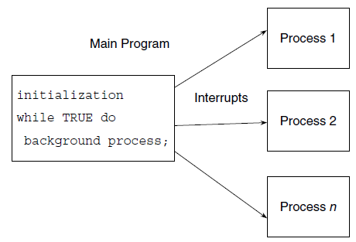
Hybrid Systems: Foreground/Background Systems

Slide 44
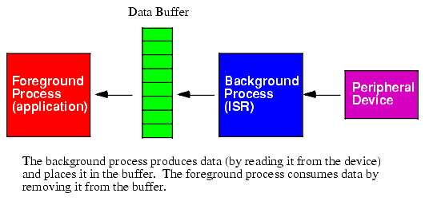
Hybrid Systems: Foreground/Background Systems

Slide 45
Hybrid Systems: Foreground/Background Systems
All real-time solutions are just special cases of the foreground/background systems.
Polled loop is simply a foreground/background system with no foreground, and a polled loop as a background. Adding interrupts for synchronization yields a full foreground/background system.
State-driven code is a foreground/background system with no foreground and phase-driven code for a background.
Coroutine systems are just a complicated background process.
Interrupt-only systems are foreground/background systems without background processing.

Slide 46
Hybrid Systems: Background Processing
As a noninterrupt-driven task, the background processing should include anything that is not time critical.
Tasks performed in the background:
- low-priority display updates
logging to printers,
- interfaces to slow devices
While the background process is the process with the lowest priority, it should always execute to completion provided the system utilization is less than 100% and no deadlocking occurs.
It is common, for instance, to increment a counter in the background in order to provide a measure of time loading or to detect if any foreground process has hung up.
It might also be desirable to provide individual counters for each of the foreground processes, which are reset in those processes.

Slide 47
Hybrid Systems: Background Processing
If the background process detects that one of the counters is not being reset often enough, it can be assumed that the corresponding task is not being executed and, that some kind of failure is indicated.
This is a form of software watchdog timer.
A watchdog timer (WDT) is a hardware timer that automatically generates a system reset if the main program neglects to periodically service it. It is often used to automatically reset an embedded device that hangs because of a software or hardware fault

Slide 48
Hybrid Systems: Background Processing
Certain types of low-priority self-testing can also be performed in the background.
For example, in many systems, a complete test of the CPU instruction set could be performed. This kind of test should never be performed in foreground, but should be part of a robust system design. The design and coding of these CPU instruction tests require careful planning.

Slide 49
Hybrid Systems: Initialization
Initialization of the foreground/background system consists of the following steps:
1. Disable interrupts
2. Set up interrupt vectors and stacks
3. Perform self-test
4. Perform system initialization
5. Enable interrupts
Initialization is actually the first part of the background process.
It is important to disable interrupts because many systems start up with interrupts enabled while time is still needed to set things up.

Slide 50
Hybrid Systems: Initialization
This setup consists of initializing the appropriate interrupt vector addresses, setting up stacks if it is a multiple-level interrupt system, and initializing any data, counters, arrays, and so on.
In addition, it is necessary to perform any self-diagnostic tests before enabling any interrupts.
Finally, real-time processing can begin.

Slide 51
Hybrid Systems: Real-Time Operation
The real-time or foreground operation for the foreground/background system is the same as that for the interrupt-only system.
For example, suppose it is desired to implement an interrupt handler for a 2- address computer architecture with a single interrupt. That is, one real-time task and the background process.
Upon arrival of interrupts CPU will hold off all other interrupts
explicitly re-enabled with an EPI instruction

Slide 52
Hybrid Systems: Real-Time Operation
For context-switching purposes, it is necessary to save the eight general registers, R0-R7, on the stack.
Context switching involves saving the status of the machine as it is used by the background process.
The foreground process will run to completion so its context is never saved.
Further, assume that the CPU will have the PC in memory location 6 at the time of interruption, and the address of the interrupt-handler routine (the interrupt vector) is stored in memory location 5.

Slide 53
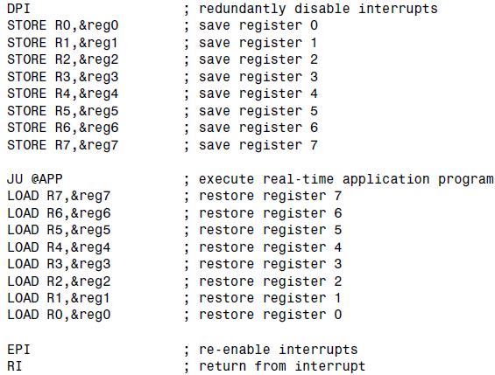
Hybrid Systems: Real-Time Operation

Slide 54
Hybrid Systems: Real-Time Operation
In many computers, block save and restore instructions are available to save and restore a set of registers to consecutive memory locations.
The background program would include the initialization procedure and any processing that was not time critical, and would be written in a high-order language.
If the program were to be written in C, it might appear as:
void main (void)
/*allocate space for context variable */
int reg0, reg1, reg2, reg3, reg4, reg5, reg6, reg7;
/*declare other global variables here */
{
init(); /*initialize system */
while (TRUE) /*background loop */
background(); /* non-real-time processing here */
}

Slide 55
Hybrid Systems: Real-Time Operation
Foreground/background systems typically have good response times, since they rely on hardware to perform scheduling as in many embedded real-time systems.
“home-grown” foreground/background systems have at least one major drawback: interfaces to complicated devices and networks must be written which is tedious and error-prone.
These types of systems are best implemented when the number of foreground tasks is fixed and known a priori.
As with the interrupt-only system, the foreground/background system is vulnerable to timing variations, unanticipated race conditions, hardware failures, and so on.

Slide 56
Hybrid Systems: Full-Featured Real-Time Operating Systems
The foreground/ background solution can be extended into an operating system by adding additional functions such as network interfaces, device drivers, and complex debugging tools.
These types of systems are readily available as commercial products.
Such systems rely on a complex operating system using round-robin, preemptive priority, or a combination of both schemes to provide scheduling; the operating system represents the highest priority task, kernel, or supervisor.

Slide 57
The Task-Control Block Model
Most popular method for implementing commercial, full-featured, real-time operating systems as the number of real-time tasks can vary.
This architecture is used in interactive on-line systems where tasks (associated with users) come and go.
This technique can be used in round-robin, preemptive-priority, or combination systems, although it is generally associated with round-robin systems with a single clock.
In preemptive systems, however, it can be used to facilitate dynamic task prioritization.

Slide 58
The Task-Control Block Model
The main drawback of the task-control block model is that when a large number of tasks are created, the overhead of the scheduler can become significant.
In the task-control block (TCB) model each task is associated with a data structure, called a task control block that contains
- PC
- register contents
- an identification string or number
- a status
- a priority if applicable.
The system stores these TCBs in one or more data structures, such as a linked list.

Slide 59
The Task-Control Block Model: Task States
The operating system manages the TCBs by keeping track of the status or state of each task. A task typically can be in any one of the four following states:
1. Executing
2. Ready
3. Suspended (or blocked)
4. Dormant (or sleeping)

Slide 60
The Task-Control Block Model: Task States
The executing task is the one that is running, and in a single-processing system there can be only one.
A task can enter the executing state when it is created (if no other tasks are ready), or from the ready state (if it is eligible to run based on its priority or its position in the round-robin ready list).
When a task is completed it returns to the suspended state.
Tasks in the ready state are those that are ready to run but are not running.
A task enters the ready state if it was executing and its time slice runs out, or it was preempted.
If it was in the suspended state, then it can enter the ready state if an event that initiates it occurs.
If the task was in the dormant state, then it enters the ready state upon creation of another task.
Tasks that are waiting on a particular resource, and thus are not ready, are said to be suspended or blocked.

Slide 61
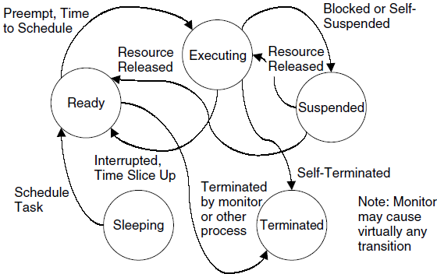
The Task-Control Block Model: Task States

Slide 62
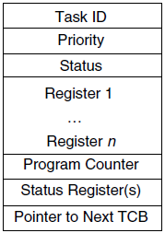
The Task-Control Block Model: Task Management
The operating system is the highest priority task.
Every hardware interrupt and every system-level call (such as a request on a resource) invokes the real-time operating system.
The operating system is responsible for maintaining
- a linked list containing the TCBs of all the ready tasks, a second linked list of those in the suspended state.
- a table of resources and a table of resource requests.
Each TCB contains the essential information normally tracked by the interrupt service routine.

Slide 63
The Task-Control Block Model: Task Management
Interrupt-service-routine model:
- Resources are managed by the operating systems
TCB model:
- Tasks track their own resources.
The TCB model is useful when the number of tasks is indeterminate at design time or can change while the system is in operation.
TCB Model is invoked
Operating system checks the ready list to see if next task is eligible for execution
If it is eligible:
TCB of currently executing task is moved to end of ready list, eligible task is removed from the ready list and its execution begins.
Task management can be achieved simply by manipulating the status word

Slide 64
The Task-Control Block Model: Task Management
For example, if all of the TCBs are set up in the list with the status word initially set to “dormant,” then tasks can be added by changing the status to “ready” when the TCB has been initialized.
During run time the status words of tasks are set accordingly, either to “executing” in the case of the next eligible task or back to “ready” in the case of the interrupted task.
Blocked tasks have their status word changed to “suspended.”
Completed tasks can be “removed” from the task list by resetting the status word to dormant.
This approach reduces overhead because it eliminates the need for dynamic memory management of the TCBs. It also provides deterministic performance because the TCB list is of constant size.

Slide 65
The Task-Control Block Model: Resource Management
In addition to scheduling, the operating system checks the status of all resources in the suspended list.
If a task is suspended due to a wait for a resource, then that task can enter the ready state only upon availability of the resource.
The list structure is used to arbitrate two tasks that are suspended on the same resource.
If a resource becomes available to a suspended task, then the resource tables are updated and the eligible task is moved from the suspended list to the ready list.

Slide 66
The Task-Control Block Model: Resource Management
As a process executes, it changes its state and at any time, and it may be in one, but only one, of the following
states at any instant:
Dormant (or sleeping) The task has been created and initialized. It is not yet ready to execute, that is, in this state, the process is not eligible to execute.
Ready Processes in this state are those that are released and eligible for execution, but are not executing. A process enters the ready state if it was executing and its time-slice runs out, or if it was preempted. If a process was in the suspended or blocked state, then it enters the ready state if an event that initiates it occurs.

Slide 67
The Task-Control Block Model: Resource Management
Executing When a process is executing its instructions are being executed.
Suspended (or blocked) Processes that are waiting for a particular resource, and thus are not ready, are said to be in the suspended or blocked state.
Terminated The process has finished execution, or has self-terminated or aborted, or is no longer needed.
Similar to processes, threads can be in only one of these states at any instant.
Many modern operating systems allow processes created within the same program to have unrestricted access to the shared memory through a thread facility.

Slide 68
The Task-Control Block Model: Resource Management

Slide 69
THEORETICAL FOUNDATIONS OF REAL-TIME OPERATING SYSTEMS
Most real-time systems are inherently concurrent, that is, their natural interaction with external events requires multiple simultaneous tasks to cope with multiple threads of control.
A process is the active object of a system and is the basic unit of work handled by the scheduler.

Slide 70
Process Scheduling
In order to meet a program’s temporal requirements in real-time systems a strategy is needed for ordering the use of system resources, and a mechanism needed for predicting the worstcase performance (or response time) when a particular scheduling policy is applied.
There are two general classes of scheduling policies: pre-run-time and run-time scheduling. The goal of both types of scheduling is to satisfy time constraints.
In pre-run-time scheduling, the objective is to create a feasible schedule offline, which guarantees the execution order of processes and prevents simultaneous access to shared resources.

Slide 71
Process Scheduling
Pre-run-time scheduling also takes into account and reduces the cost of context switching overhead, increasing the chance that a feasible schedule can be found.
Pre-run-time scheduling also takes into account and reduces the cost of context switching overhead, increasing the chance that a feasible schedule can be found.

Slide 72
Process Scheduling
In run-time scheduling, static priorities are assigned and resources are allocated on a priority basis.
Run-time scheduling relies on a complex run-time mechanism for process synchronization and communication.
This approach allows events to interrupt processes and demand resources randomly.
In terms of performance analysis, engineers must rely on stochastic simulations to verify these types of system designs.

Slide 73
Task Characteristics of a Real Workload
The workload on processors consists of tasks each of which is a unit of work to be allocated CPU time and other resources.
Every processor is assigned to at most one task at any time and Every task is assigned to at most one processor at any time.
No job is scheduled before its release time.
Each task, τ_{i} , is typically characterized by the following temporal parameters:
Precedence Constraints Specify if any task(s) needs to precede other tasks.
Release or Arrival Time r_{i ,j} The release time of the j ^{th} instance of task τ_{i} .

Slide 74
Task Characteristics of a Real Workload
Phase φ_{i} The release time of the first instant of task τ_{i} .
Response Time Time span between the task activation and its completion.
Absolute Deadline d_{i} The instant by which the task must complete.
Relative Deadline D_{i} The maximum allowable response time of the task.
Laxity Type Notion of urgency in a task’s execution.
Period p_{i} The minimum length of intervals between the release times of consecutive tasks.
Execution Time e_{i} The (maximum) amount of time required to complete the execution of a task i when it executes alone and has all the resources it requires.

Slide 75
Task Characteristics of a Real Workload
Mathematically, some of the parameters just listed are related as follows:
φ_{i} = r_{i}, ₁ and r_{i},_{k} = φ_{i} + (k − 1) ∗ p_{i}
d_{i,j} : the absolute deadline of the j ^{th} instance of task τ_{i} is as follows:
d_{i,j} = φ_{i} + (j − 1) ∗ p_{i} + D_{i}
If the relative deadline of a periodic task is equal to its period p_{i}, then
d_{i,k} = r_{i,k} + p_{i} = φ_{i} + k ∗ p_{i}
where k is some positive integer greater than or equal to one, corresponding to the k^{th} instance of that task.

Slide 76
Typical Task Model
A simple task model for describing some standard scheduling policies used in real-time systems.
Assumptions:
All tasks in the task set are strictly periodic.
The relative deadline of a task is equal to its period/frame.
All tasks are independent; there are no precedence constraints.
No task has any non-preemptible section, and the cost of preemption is negligible.

Slide 77
Task Characteristics of a Real Workload
Only processing requirements are significant; memory and I/O requirements are negligible.
For real-time systems, it is of the utmost importance that the scheduling algorithm produces a predictable schedule, that is, at all times it is known which task is going to execute next.
Many RTOS use a round-robin scheduling policy because it is simple and predictable.

Slide 78
Round-Robin Scheduling
In a round-robin system several processes are executed sequentially to completion, often in conjunction with a cyclic executive.
In round-robin systems with time slicing, each executable task is assigned a fixed-time quantum called a time slice in which to execute.
A fixed-rate clock is used to initiate an interrupt at a rate corresponding to the time slice.

Slide 79
Round-Robin Scheduling
The task executes until it completes or its execution time expires, as indicated by the clock interrupt.
If the task does not execute to completion, its context must be saved and the task is placed at the end of the executable list.
The context of the next executable task in the list is restored, and it resumes execution.
Round-robin scheduling achieves fair allocation of the CPU to tasks of the same priority by time multiplexing.

Slide 80
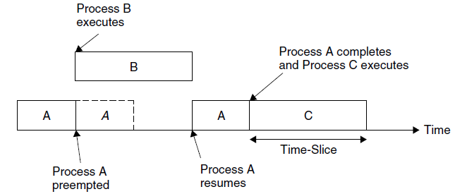
Round-Robin Scheduling

Slide 81
Round-Robin Scheduling
Round-robin systems can be combined with preemptive priority systems, yielding a kind of mixed system. Here processes A and C are of the same priority, whereas process B is of higher priority.
Process A is executing for some time when it is preempted by task B, which executes until completion.
When process A resumes, it continues until its time slice expires, at which time context is switched to process C, which begins executing.

Slide 82
Cyclic Executives
The cyclic-executive (CE) approach is very popular, as it is simple and generates a complete and highly predictable schedule.
The CE refers to a scheduler that deterministically interleaves and sequentializes the execution of periodic tasks on a processor according to a pre-run-time schedule.
In general terms, the CE is a table of procedure calls, where each task is a procedure, within a single do loop.
In the CE approach, scheduling decisions are made periodically, rather than at arbitrary times.

Slide 83
Cyclic Executives
Time intervals during scheduling decision points are referred to as frames or minor cycles, and every frame has a length, f , called the frame size.
The major cycle is the minimum time required to execute tasks allocated to the processor, ensuring that the deadlines and periods of all processes are met.
The major cycle or the hyperperiod is equal to the least common multiple (lcm) of the periods, that is,
lcm(p1, . . . pn).

Slide 84

Cyclic Executives
As scheduling decisions are made only at the beginning of every frame, there is no preemption within each frame.
The phase of each periodic task is a nonnegative integer multiple of the frame size.
It is assumed that the scheduler carries out monitoring and enforcement actions at the beginning of each frame
Frames must be sufficiently long so that every task can start and complete with a single frame. This implies that the frame size, f , is to be larger than the execution time, ei, of every task, Ti, that is,

Slide 85
Cyclic Executives: Constraints on the value of frame size.
To keep length of the cyclic schedule as short as possible, the frame size, f , should be chosen so that the hyperperiod has an integer number of frames:
To ensure that every task completes by its deadline, frames must be small so that between the release time and deadline of every task, there is at least one frame.
The following relation is derived for a worst-case scenario, which occurs when the period of a process starts just after the beginning of a frame and, consequently, the process cannot be released until the next frame.

Slide 86
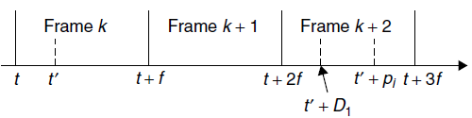
Cyclic Executives

Slide 87
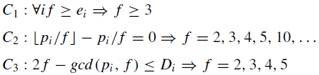
Cyclic Executives
The hyperperiod is equal to 660, since the least common multiple of 15, 20, and 22 is 660. The three conditions, C1, C2 and C3 are evaluated as follows:
From these three conditions, it can be inferred that a possible value for f could be any one of the values of 3, 4, or 5.

Slide 88
Fixed-Priority Scheduling–Rate-Monotonic Approach
In the fixed-priority scheduling policy, the priority of each periodic task is fixed relative to other tasks.
A seminal fixed-priority algorithm is the rate-monotonic (RM) algorithm.
It is an optimal static priority algorithm for the task model, in which a task with a shorter period is given a higher priority than a task with a longer period.

Slide 89
Fixed-Priority Scheduling–Rate-Monotonic Approach
Given a set of periodic tasks and preemptive priority scheduling, then assigning priorities such that the tasks with shorter periods have higher priorities (rate-monotonic), yields an optimal scheduling algorithm.
In other words, optimality of RM implies that if a schedule that meets all the deadlines exists with fixed priorities, then RM will produce a feasible schedule.
An inductive argument .

Slide 90
An inductive argument
Basis Step
Consider two fixed but non-RM priority tasks τ1 = (e₁, p₁, d₁) and τ₂ = (e₂, p₂, d₂) where τ₂ has the highest priority, and p₁ < p₂. Suppose both processes are released at the same time. It is clear that this leads to the worst-case response time for τ₁. However, at this point, in order for both processes to be schedulable, it is necessary that e₁ + e₂ ≤ p_{i}; otherwise, τ₁ could not meet its period or deadlines. Because of this relation
between the compute times and the period (deadline) of τ₂, we can obtain a feasible schedule by reversing priorities, thereby scheduling τ₁ first, that is with RM assignment.

Slide 91
Fixed-Priority Scheduling–Rate-Monotonic Approach
Induction Step
Suppose that τ₁, . . . , τ_{n} are schedulable according to RM, with priorities in ascending order, but the assignment is not RM. Let τ_{i} and τ_{i+1}, 1 ≤ i < n, be the first two tasks with non-RM priorities. That is, p_{i} < p_{i+1}. The “proof” proceeds by interchanging the priorities of these two processes and showing the set is still schedulable using the n = 2 result. The proof continues by interchanging non-RM pairs in this fashion until the assignment is RM. Therefore if a fixed-priority assignment can produce a feasible schedule, so can RM assignment.

Slide 92
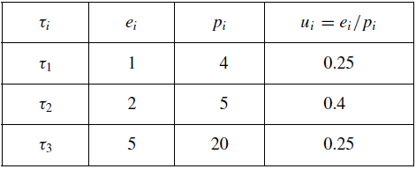
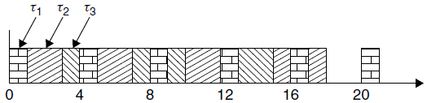

Fixed-Priority Scheduling–Rate-Monotonic Approach
RM-schedule for the task set. All tasks are released
at time 0. Since task τ1 has the smallest period, it is the highest priority task and is scheduled first. Note that at time 4 the second instance of task τ1 is released and it preempts the currently running task τ3, which has the lowest priority.
Here utilization, ui , is equal to the fraction of time a task with period pi and
execution time ei keeps a processor busy. Recall that the processor utilization of
n tasks is given by

Slide 93

Theorem (RMA Bound)
Any set of n periodic tasks is RM schedulable if the processor utilization, U, is no greater than n(2^{1/n} − 1).
This means that whenever U is at or below the given utilization bound, a schedule can be constructed with RM. In the limit when the number of tasks n=∞, the maximum utilization limit

Slide 94
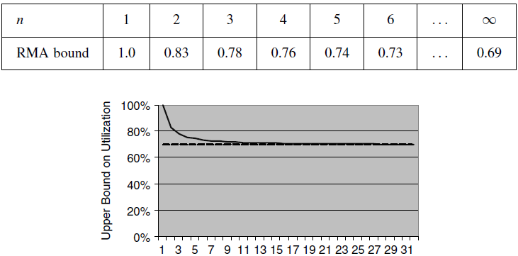
Cyclic Executives

Slide 95
Dynamic-Priority Scheduling: Earliest-Deadline–First Approach
In dynamic-priority schemes the priority of the task with respect to that of the other tasks changes as tasks are released and completed.
One of the most well-known dynamic algorithms, earliest-deadline first (EDF), deals with deadlines rather than execution times.
The ready task with the earliest deadline has the highest priority at any point of time.

Slide 96
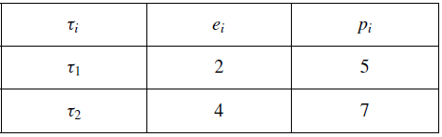
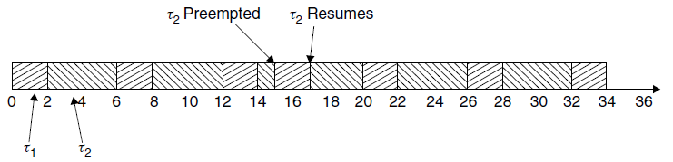
Basic Results of EDF Policy
EDF is optimal for a uniprocessor, with task preemption being allowed.
In other words, if a feasible schedule exists, then the EDF policy will also produce a feasible schedule.
There is never a processor idling prior to a missed deadline.

Slide 97
EDF Policies:
Schedulable utilization is a measure of performance of algorithms used to schedule periodic tasks.
EDF is more flexible and achieves better utilization.
In case of overloads, when tasks are scheduled using EDF, it is difficult to predict which tasks will miss their deadlines during overloads.
A late task that has already missed its deadline has a higher priority than a task whose deadline is still in the future so if the execution of a late task is allowed to continue, this may cause many other tasks to be late.
A good overrun management scheme is needed for such dynamic-priority algorithms employed in systems where overload conditions cannot be avoided.

Slide 98
RMA Policies:
The timing behavior of a system scheduled according to a fixed-priority algorithm is more predictable than that of a system scheduled according to a dynamic-priority algorithm.
In case of overloads, RM is stable in the presence of missed deadlines; the same lower-priority tasks miss deadlines every time, there is no effect on higher-priority tasks.

Slide 99
RMA Policies:
Example
Although τ₁ and τ₂ release simultaneously, τ₁ executes first because its deadline is earliest. At t = 2, τ₂ can execute. Even though τ₁ releases again at t = 5, its deadline is not earlier than τ₃. This sequence continues until time t = 15 when τ₂ is preempted, as its deadline is later (t = 21) than τ₁ (t = 20); τ2 resumes when τ₁ completes.

Slide 100
Static Vs Dynamic Priority Algorithms
Tasks T₁(2, 0.9), T₂(5, 2.3)
Dynamic Priority
T₁
T₂
0
2
4
6
8
10
Static Priority
T₁
T₂
0
2
4
6
8
10

Slide 101
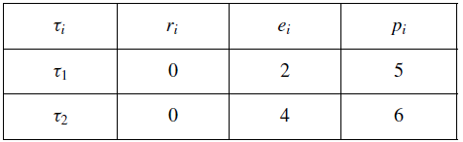
Draw Execution Trace Timeline
EDF misses deadlines for both τ1 and τ2 (assuming that the late task is allowed to complete at its current assigned priority).
RM misses the deadline of τ2 only (every time).
RM tends to need more preemption; EDF only preempts when an earlier-deadline task arrives.

